Slide 1
Baybayin Handwritting Prediction.
WELCOME
A classification machine learning project.

Slide 2
Table of Contents.
01 Intro
02 Problem
03 Dataset
04 Preprocessing
05 EDA
Introduction and background about Baybayin.
Problem description.
How the data was acquired and how the raw data looks.
06 Model
Getting the dataset ready and workable.
Explore the processed data.
The best model for the dataset.

Slide 3
We will talk about Baybayin first.
01
Precolonial writing in the Philippines

Slide 4
Background
BAYBAYIN
Baybayin also known as Alibata
Baybayin is an ancient script used in the Philippines before the arrival of the Spanish colonizers. It is also known as the Alibata, a term coined in the early 20th century by a Filipino scholar, Paul Versoza. The script consists of 17 basic characters that represent syllables.
Notes:
An ancient script used by the Filipinos before the arrival of the Spanish colonizers.
It has 17 basic characters that represent syllables.

Slide 5
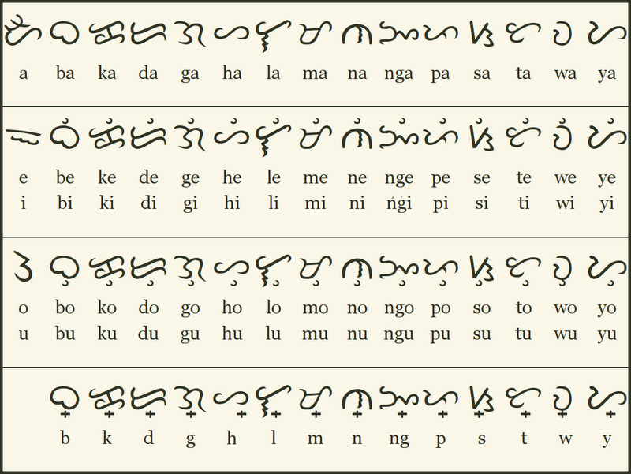
14 consonants
3 vowels
Note:
da and ra uses the same letter
Consonants with pamudpod
Notes:
Pamudpod is used to cancel out the vowel

Slide 6
Examples
Original Writing
Baybayin
ᜌᜓᜇᜒᜃ
ᜑᜓᜐ᜔ᜎᜒᜈ᜔
ᜇᜓᜊᜒᜇ᜔ᜆ᜔
Eureka – Yu-re-ka
Khuslen – Hu-s-len
Robert – Ro-be-r-t

Slide 7
Fun Facts
Alibata.
The term "Alibata" is a combination of the first three letters of the Arabic alphabet, "Alif”, "Ba”, and "Ta".
Baybayin.
is derived from the Tagalog word "baybay", meaning "to spell" or "to write".
Writing.
Baybayin characters can be written in different orientations, including left-to-right, right-to-left, and top-to-bottom.
Notes:
There is no evidence to suggest that the Baybayin script has any direct connection to the Arabic script

Slide 8
Very interesting facts!

Slide 9
Solve this problem.
02
Problem description

Slide 10
Problem we’re trying to solve
Baybayin handwriting prediction is challenging due to the complex shapes and variations of the characters, as well as the absence of standardized forms or fonts, making it difficult to obtain a large and diverse labeled dataset.
The project aims to create a Baybayin handwriting prediction project by addressing challenges related to data collection, feature extraction, classification algorithms, and model evaluation.

Slide 11
We will talk about the dataset next.
03
Unprocessed Baybayin Dataset

Slide 12
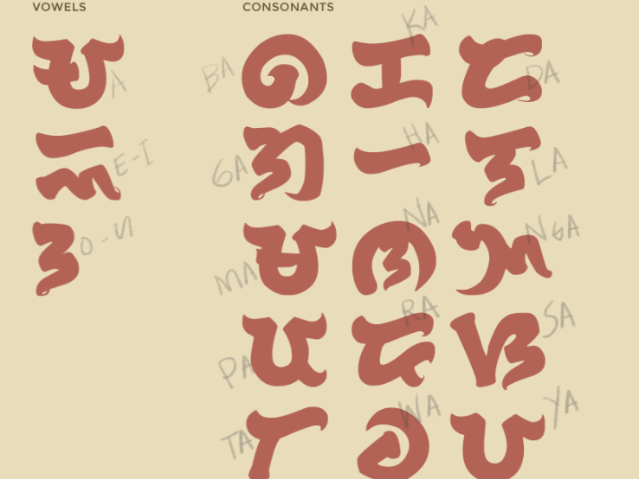
Mendeley Data.
I got my dataset from data.mendeley.com, but the letter sample images are unevenly distributed among the folders, and the image sizes vary.

Slide 13
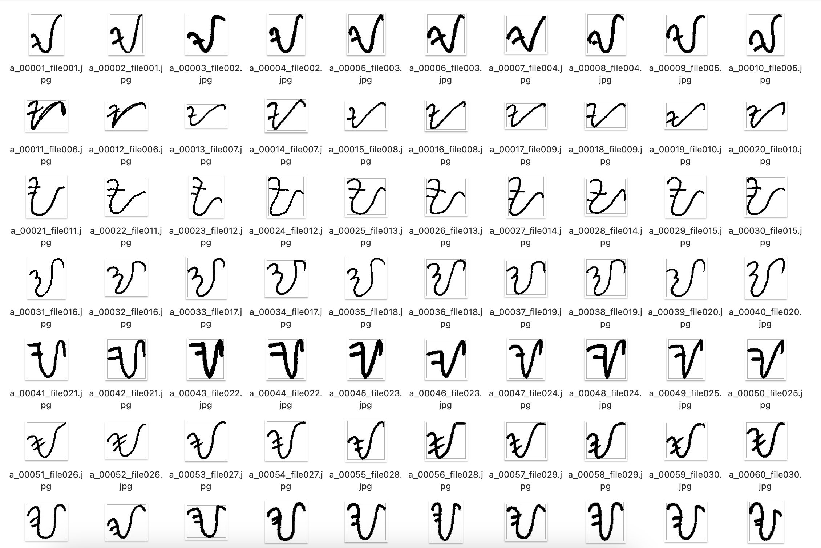
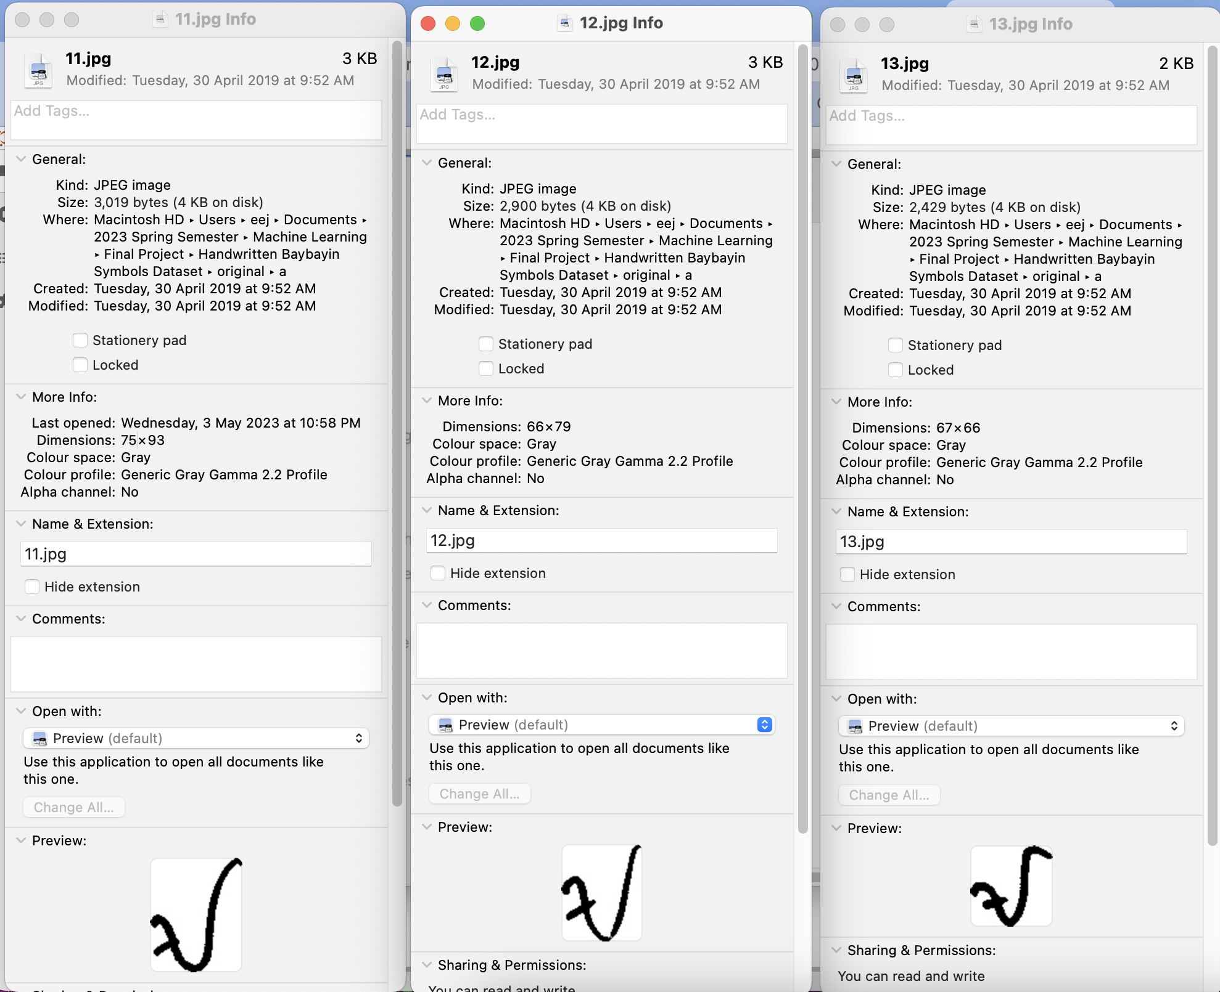
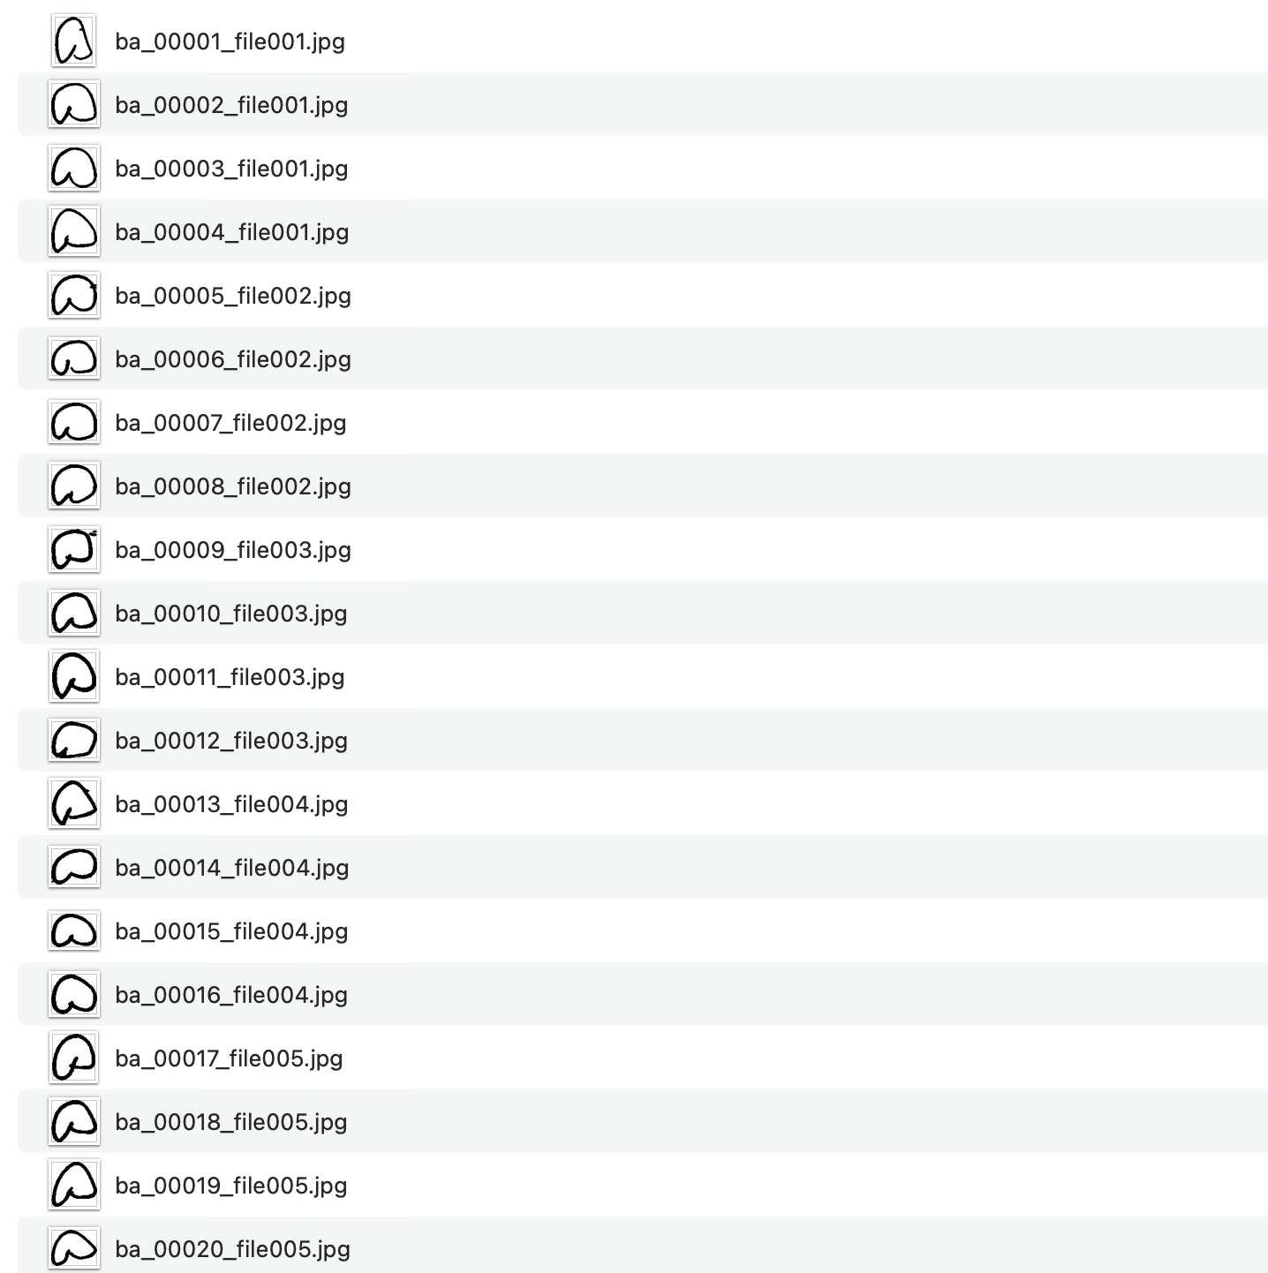
Problems
File names can’t be used as ‘ID’
In .jpg format
Different sizes

Slide 14
Moving on to preprocessing.
04
Steps to make the dataset workable

Slide 15
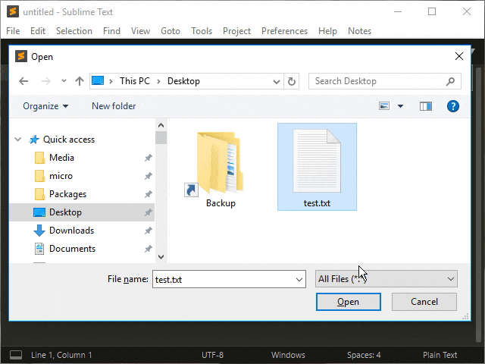
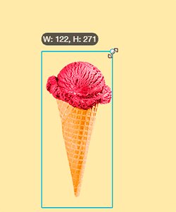
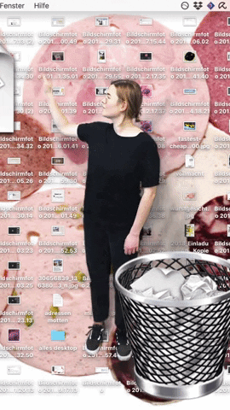
Preprocessing
Lessened to 1000 samples each letter
Renaming
Resizing
Notes:
Renaming – Renamed the images to be able to use them as their “ID”
Resizing – Resized the samples to a uniform size of 28x28 for efficiency and consistency
For balanced training data and avoid overfitting and because imbalance in the data can lead to biased estimates of feature importance

Slide 16

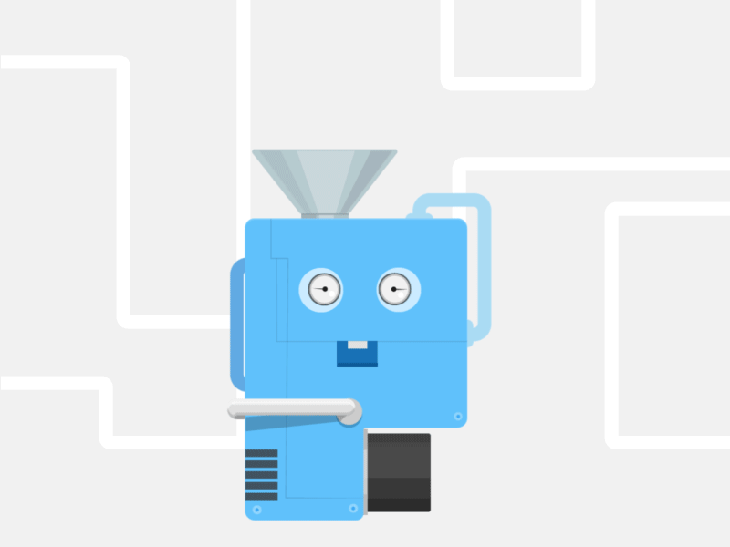

Preprocessing
Made an X, y and ID list
Converted to a Numpy Array
Save them into .csv file
Notes:
The X, y, and ID empty list allows us to add samples to the list as we iterate through the data
Once we have collected all the samples in the list, we can then convert it to a Numpy array
Save it as .csv file and it’s ready for machine learning

Slide 17
Let’s talk about the EDA now.
05
Exploratory Data Analysis

Slide 18
Dataset
We have 784 columns representing the pixels in each image sample (image dimension: 28x28)
17,000 rows representing all the samples (1,000 samples each letter)
The y dataset's target column is the numerical representation of each letter
Baybayin | Romanized | Numerical
ᜀ | a | 0
ᜊ | ba | 1
ᜃ | ka | 2
ᜇ | da-ra | 3
ᜁ | e-i | 4
ᜄ | ga | 5
ᜑ | ha | 6
ᜎ | la | 7
ᜋ | ma | 8
Baybayin | Romanized | Numerical
ᜈ | na | 9
ᜅ | nga | 10
ᜂ | o-u | 11
ᜉ | pa | 12
ᜐ | sa | 13
ᜆ | ta | 14
ᜏ | wa | 15
ᜌ | ya | 16

Slide 19
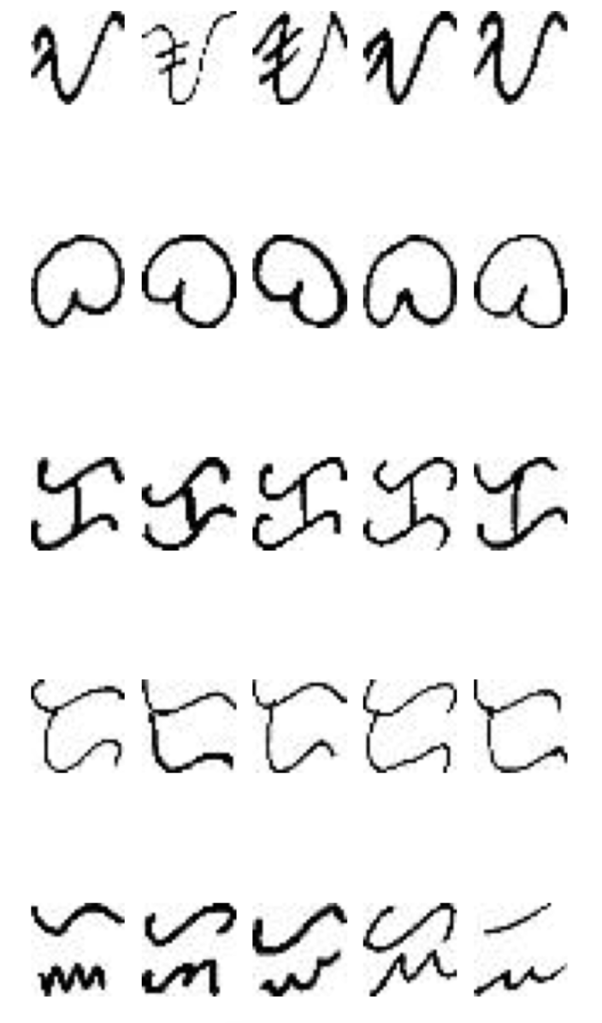
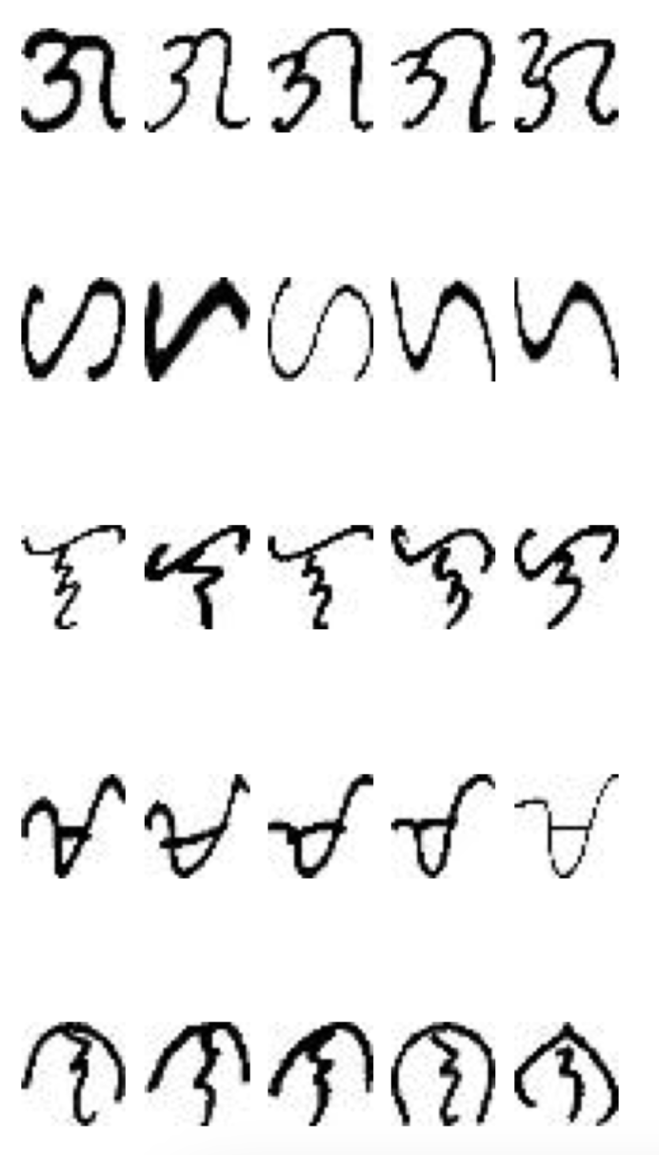
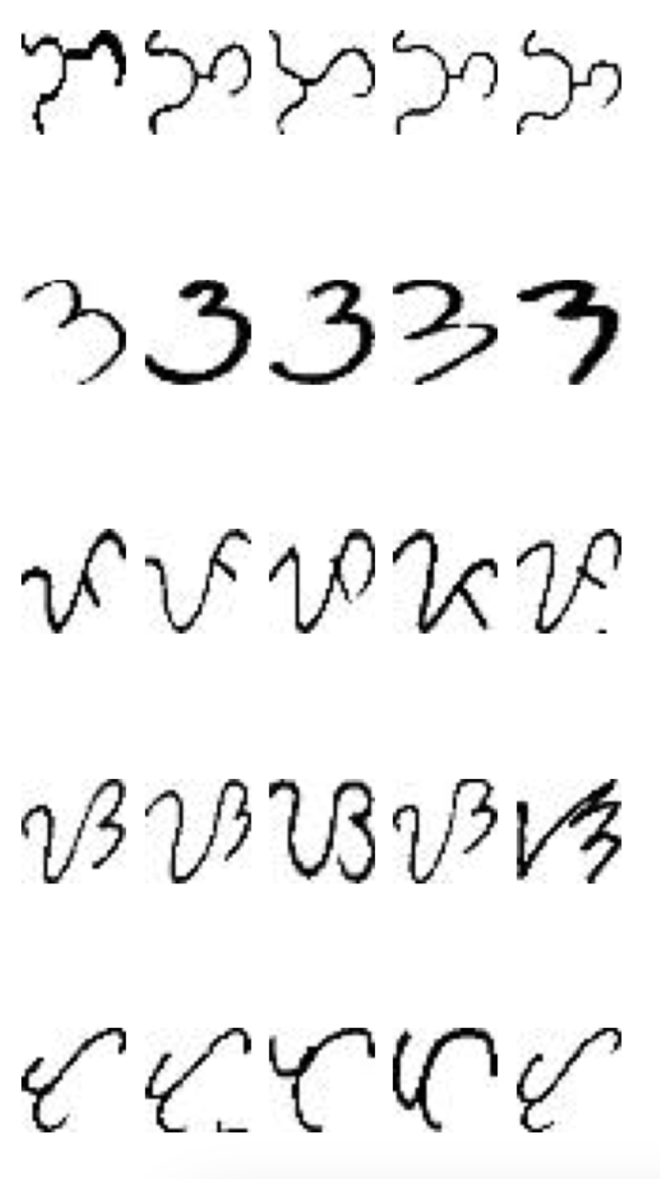
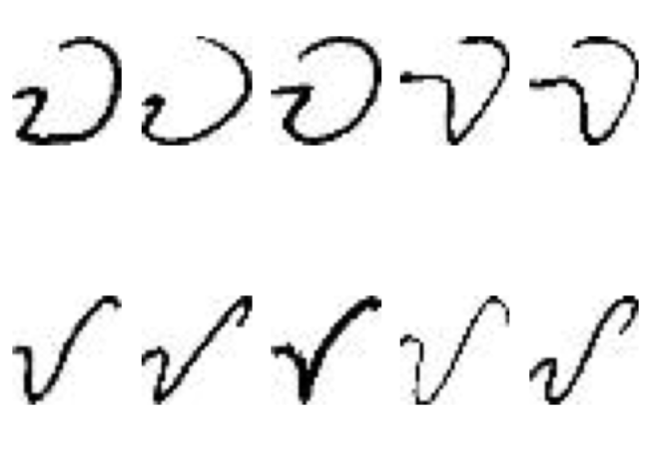
Five Samples
A
GA
NGA
WA
BA
HA
O-U
YA
KA
LA
PA
DA
MA
SA
E-I
NA
TA

Slide 20
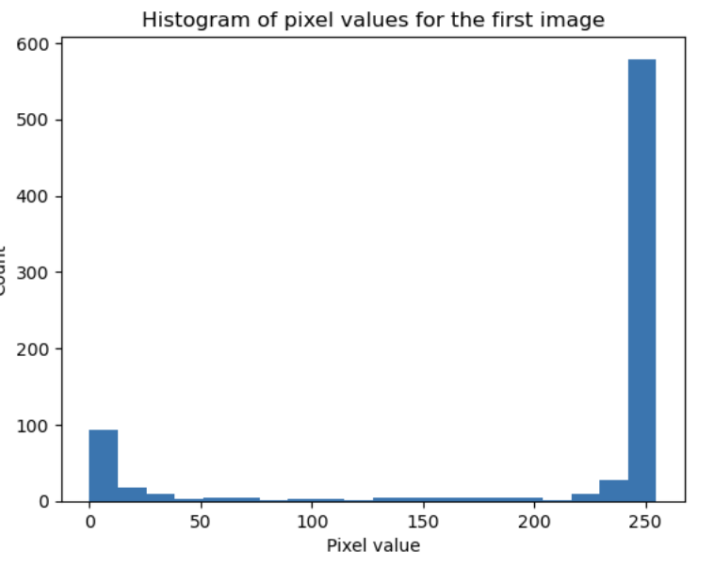
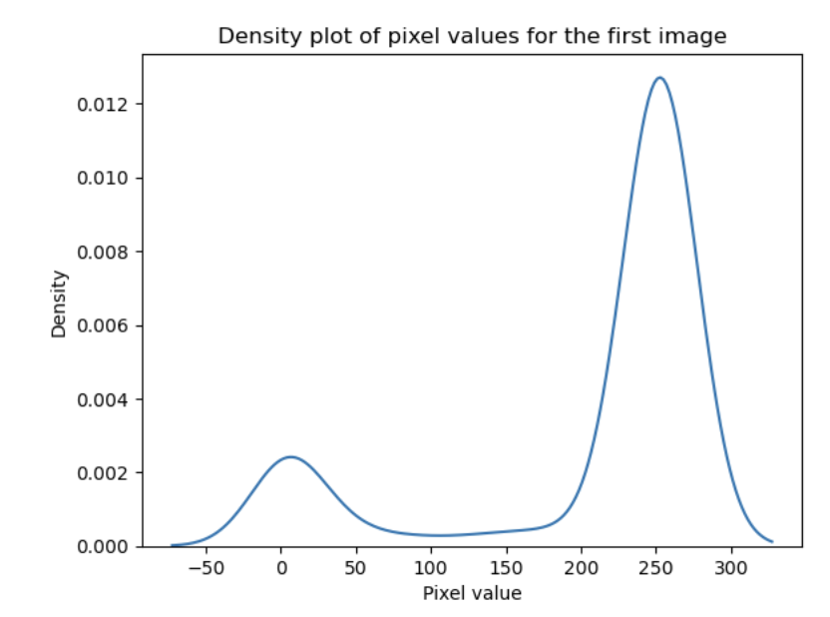
Image Density
Notes:
Shows the brightness of the images.

Slide 21
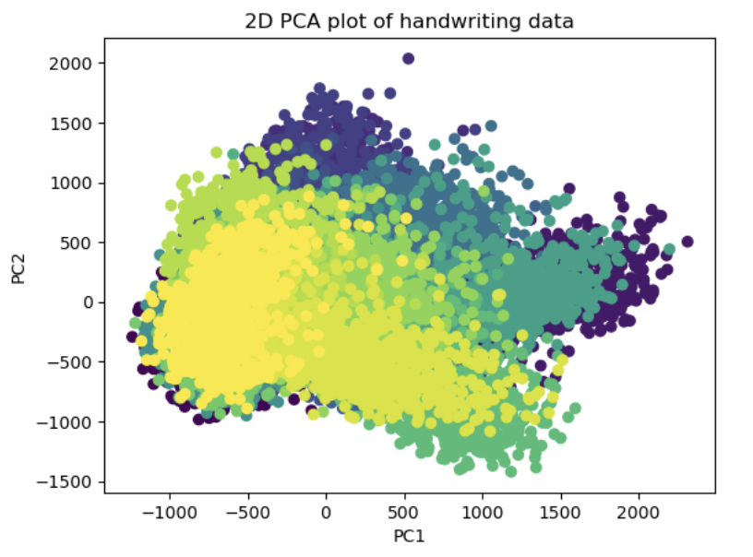
PCA
Notes:
I used PCA to visualize the key features that distinguish one letter from another, such as the shape of the letter, the thickness of the strokes, or the angles of the lines.

Slide 22
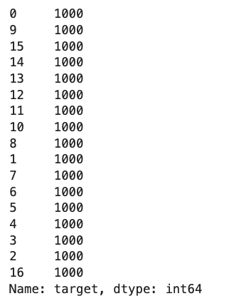
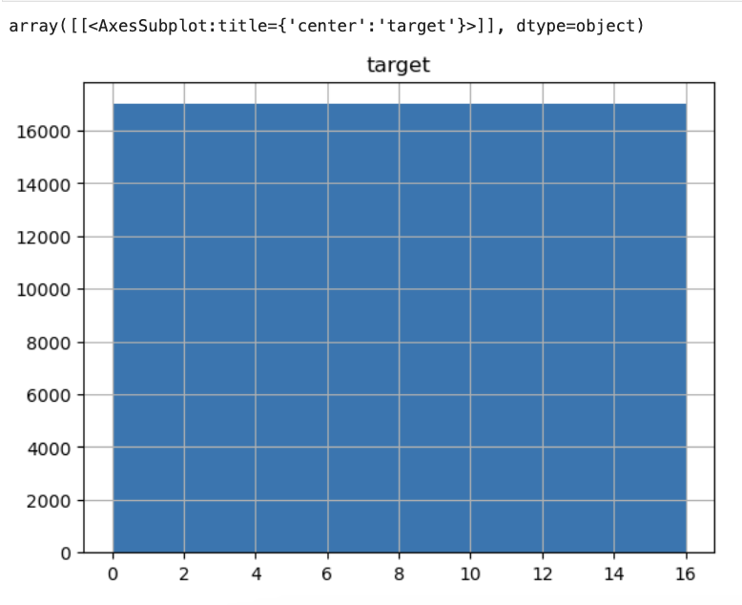
'target’ histogram
Notes:
To check if our data is balanced

Slide 23
Lastly, the Model.
06
Choosing the best model for the data

Slide 24
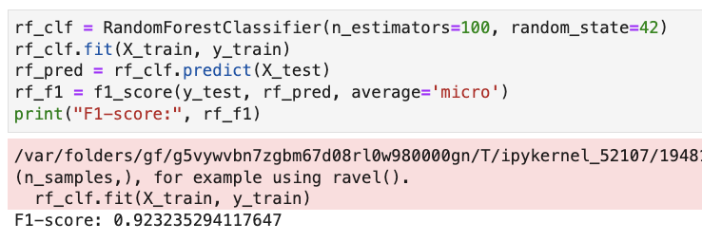
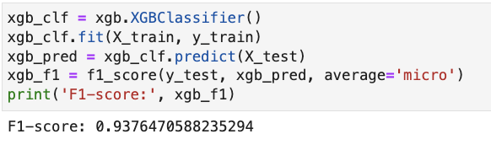
What’s the best model?
Random Forest Classifier
XGBoost Classifier

Slide 25
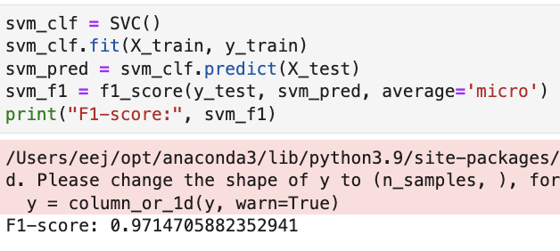
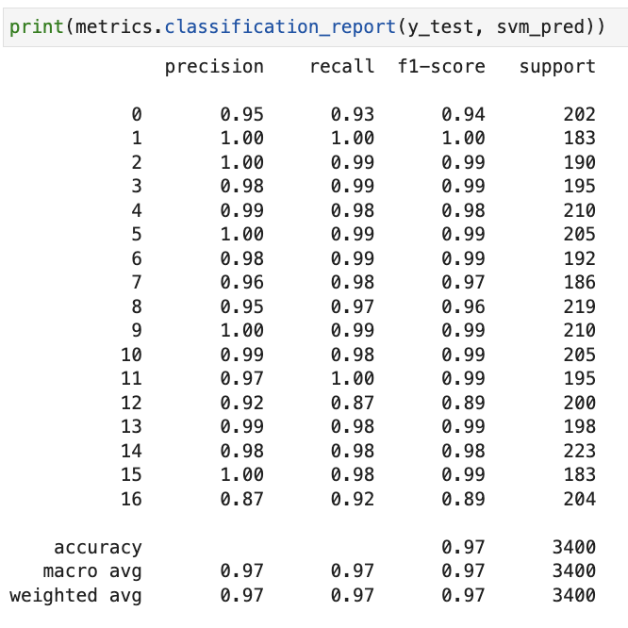
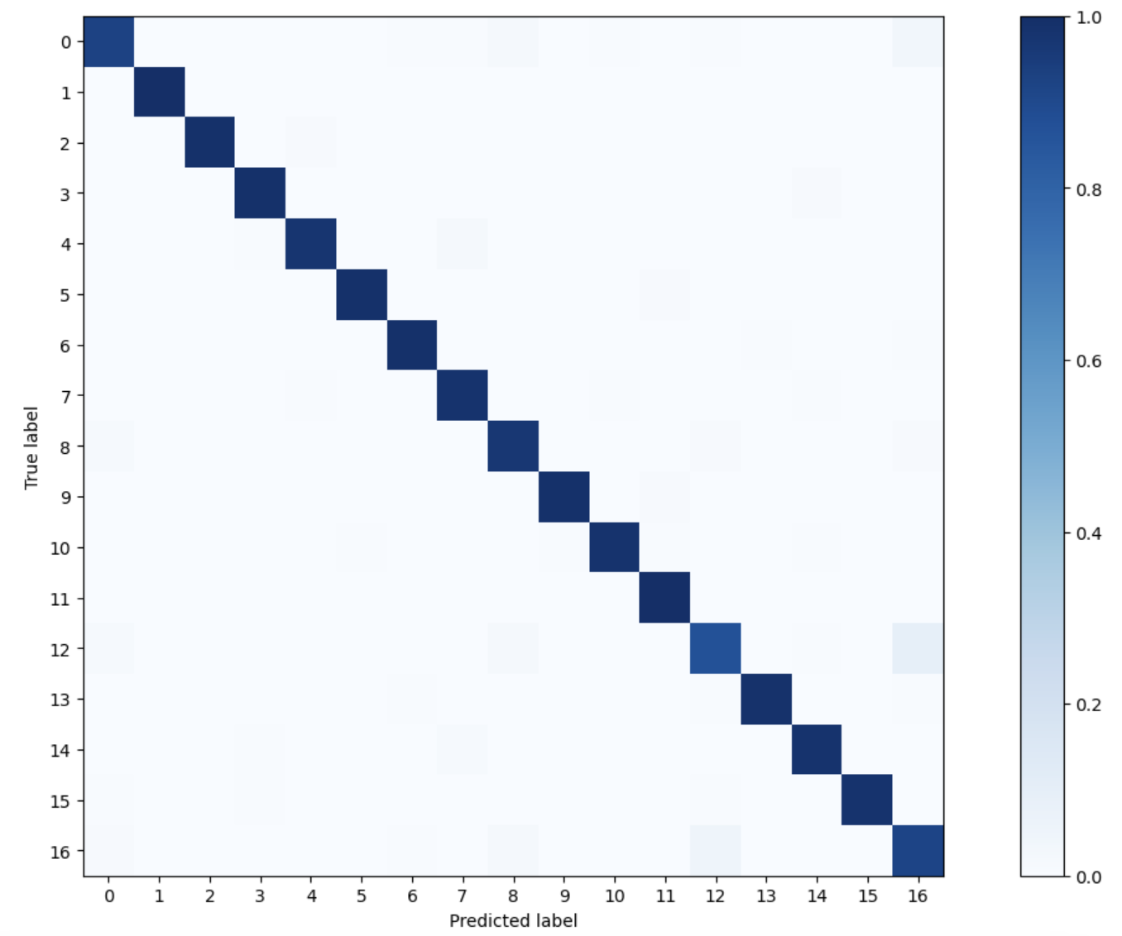
Support Vector Machine
ᜉ | pa
Notes:
The model appears to perform well with high precision, recall, and F1-scores for most classes, except for class 12 which has a lower precision and recall.
The macro and weighted averages across all classes are also high, indicating that the model performs well overall.
The accuracy of the model is 0.97, which means that it correctly predicts the class label for 97% of the instances in the test dataset.

Slide 26
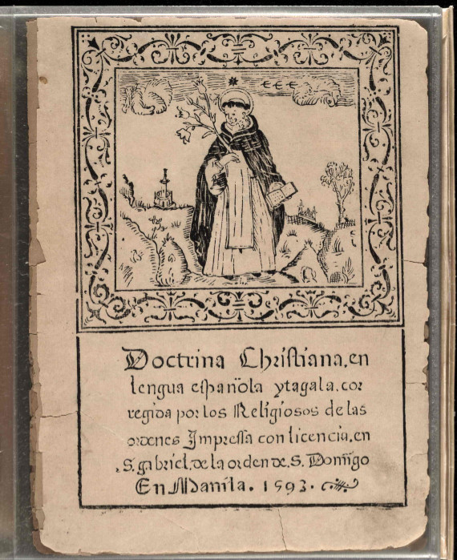
Conclusion
SVM outperformed other models, achieving a 97.15% accuracy in classifying the dataset.
The model accurately predicts positive and negative classes with high precision, recall, and F1-score, indicating a balanced prediction.
In conclusion, the SVM model is suitable for the dataset and can classify the data accurately.
Notes:
Based on the analysis conducted, we can conclude that SVM is the best model for classifying the given dataset. The SVM model achieved an overall accuracy of 97.147%, which is higher than the accuracy achieved by other models such as Random Forest, XGBoost, SGD Classifier, and Naive Bayes.
Additionally, we can observe from the confusion matrix that the model is performing well in predicting both the positive and negative classes. The precision, recall, and F1-score are all high for most of the classes, indicating that the model is balanced in its predictions.
Overall, we can say that the SVM model is a good fit for the given dataset and can be used for accurate classification of the data. However, further analysis can be conducted to improve the performance of the model, such as hyperparameter tuning, feature engineering, and data preprocessing.

